Slide 1
Crytojacking
Modern Crime and Society

Slide 2
Origins – “Carjacking”
Carjacking (Car + Hijacking) = A robbery where the item stolen is a car. This can include even when the car is occupied.
Some Methods:
The Bump—The attacker bumps the victim's vehicle from behind. The victim gets out to assess the damage and exchange information. The victim's vehicle is taken.
Good Samaritan—The attacker(s) stage what appears to be an accident. They may simulate an injury. The victim stops to assist, and the vehicle is taken.
The Ruse—The vehicle behind the victim flashes its lights or the driver waves to get the victim's attention. The attacker tries to indicate that there is a problem with the victim's car. The victim pulls over and the vehicle is taken.

Slide 3


Slide 4
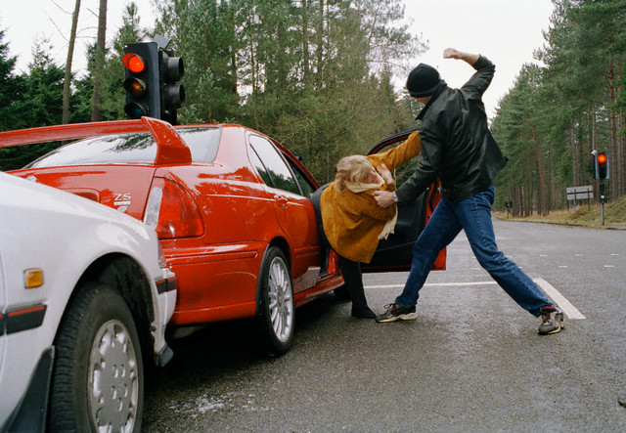

Slide 5
Computer Processing Power (CPU)
Most of the time, we don’s use most of our Computer’s processing power even when actively using our computer.
We also tend to leave our computers on, but Idle or in power-saving mode.
So, some innovative people came up with the idea of using people’s idle computing power across a large network. This is called “Distributed Computing”:
Distributed computing is a model in which components of a software system are shared among multiple computers to improve efficiency and performance.

Slide 6
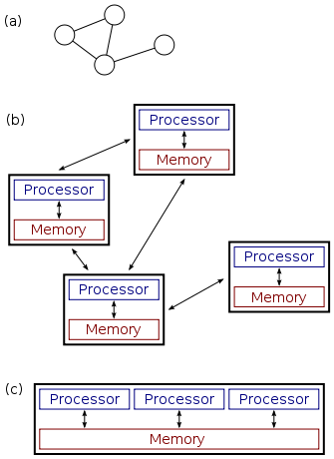

Slide 7


Slide 8
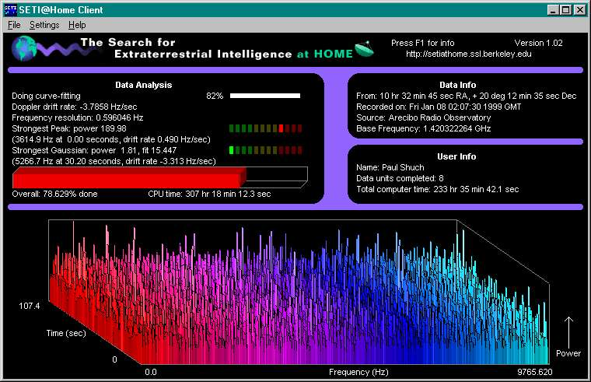

Slide 9
Cryptomining and Distributed Computing Power
In addition, some people have developed ways to use distributed computing power to mine for crypto currency.
Remember, the more processing power you have, the faster you can solve the mining “problems” and win the race to get the rewards
For example, you go to a website, that website has advertisements you don’t want.
So, you can “opt-in” at the website for crypto mining. While you are using the site, your computer mines cryptocurrency but you get no advertisements!

Slide 10


Slide 11
Cryptojacking
Cryptojacking is the merger of the idea of distributed computing and carjacking.
Only are not “jacking”cars, but “jacking” computer processing power.
Unlike ransomware, crytpojacking does not use encryption to lock a computer down.
Instead, the malware program will use a computer’s idle processing power in secret
What is the malware doing? Using the computer’s processing power to mine crytocurrencies for the controller

Slide 12
Cryptojacking
Hackers can hack a website server and insert code into a website.
Every user who visits that website will then be cryptomining while there. But the beneficiary is not the site owner, but the hacker.
Files are only temporary “batch” files so harder to trace.
For example, a botnet program called “Zero Access” is said to have earned $2.7 million in bitcoins (as early as 2013).

Slide 13
February - 2018
“Thousands of websites around the world, including many operated by governments, have been infected by hackers using the sites' computing power to "mine" cryptocurrencies, security researchers said.
The attack is the first major incident made public in which a new breed of hackers took over a large numbers of websites to effectively create currencies like bitcoin which are generated by using computing power.
The attacks made public over the weekend by British security researcher Scott Helme showed more than 4,000 website were infected in this manner, including those of the British data protection and privacy watchdog and the US federal courts system.
http://www.thejakartapost.com/life/2018/02/13/thousands-of-websites-infected-by-crypto-mining-malware.html

Slide 14


Slide 15
April 2018
ESEA (the E-Sports Entertainment Association) admitted that its software — which serious Counter-Strikeplayers use to play each other in anti-cheating modes — had been altered to secretly mine Bitcoins. At the time, ESEA blamed an unidentified staffer.
The software used players’s graphic cards power while they were playing the game and had ESEA’s client open.
Infected 14,000 players’ computers
The mining began on April 13th and affected thousands of gamers, who unwittingly mined over $3,700 worth of the currency

